Slide 1
Data Structures and Algorithms
Lecture 7: Sorting

Slide 2
Why Sorting?
Practical application
  People by last name
  Countries by population
  Search engine results by relevance
Fundamental to other algorithms
Different algorithms have different asymptotic and constant-factor trade-offs
  No single ‘best’ sort for all scenarios
  Knowing one way to sort just isn’t enough
Many to approaches to sorting which can be used for other problems

Slide 3
Problem statement
There are n comparable elements in an array and we want to rearrange them to be in increasing order
Pre:
  An array A of data records
  A value in each data record
  A comparison function
    <, =, >, compareTo
Post:
  For each distinct position i and j of A, if i<j then A[i] ≤ A[j]
  A has all the same data it started with

Slide 4
Sorting Classification
In memory sorting |  |  | External sorting
Comparison sorting Ω(N log N) |  | Specialized Sorting
O(N²) | O(N log N) | O(N) | # of tape accesses
Bubble Sort Selection Sort Insertion Sort Shell Sort | Merge Sort Quick Sort Heap Sort | Bucket Sort Radix Sort | Simple External Merge Sort Variations

Slide 5
O(n²) Comparison Sorting

Slide 6
Bubble sort
bubble sort: orders a list of values by repetitively comparing neighboring elements and swapping their positions if necessary
more specifically:
  scan the list, exchanging adjacent elements if they are not in relative order; this bubbles the highest value to the top
  scan the list again, bubbling up the second highest value
  repeat until all elements have been placed in their proper order

Slide 7
"Bubbling" largest element
Traverse a collection of elements
  Move from the front to the end
  "Bubble" the largest value to the end using pair-wise comparisons and swapping
Swap
0 1 2 3 4 5
42
77
77
42
35
12
101
5

Slide 8
"Bubbling" largest element
Traverse a collection of elements
  Move from the front to the end
  "Bubble" the largest value to the end using pair-wise comparisons and swapping
0 1 2 3 4 5
Swap
35
77
42
77
35
12
101
5

Slide 9
"Bubbling" largest element
Traverse a collection of elements
  Move from the front to the end
  "Bubble" the largest value to the end using pair-wise comparisons and swapping
0 1 2 3 4 5
Swap
12
77
42
35
77
12
101
5

Slide 10
"Bubbling" largest element
Traverse a collection of elements
  Move from the front to the end
  "Bubble" the largest value to the end using pair-wise comparisons and swapping
0 1 2 3 4 5
42
35
12
77
101
5
No need to swap

Slide 11
"Bubbling" largest element
Traverse a collection of elements
  Move from the front to the end
  "Bubble" the largest value to the end using pair-wise comparisons and swapping
0 1 2 3 4 5
Swap
5
101
42
35
12
77
101
5

Slide 12
"Bubbling" largest element
Traverse a collection of elements
  Move from the front to the end
  "Bubble" the largest value to the end using pair-wise comparisons and swapping
0 1 2 3 4 5
101
42
35
12
77
5
Largest value correctly placed

Slide 13
Bubble sort code
public static void bubbleSort(int[] a) {
for (int i = 0; i < a.length; i++) {
for (int j = 1; j < a.length - i; j++) {
// swap adjacent out-of-order elements
if (a[j-1] > a[j]) {
swap(a, j-1, j);
}
}
}
}

Slide 14
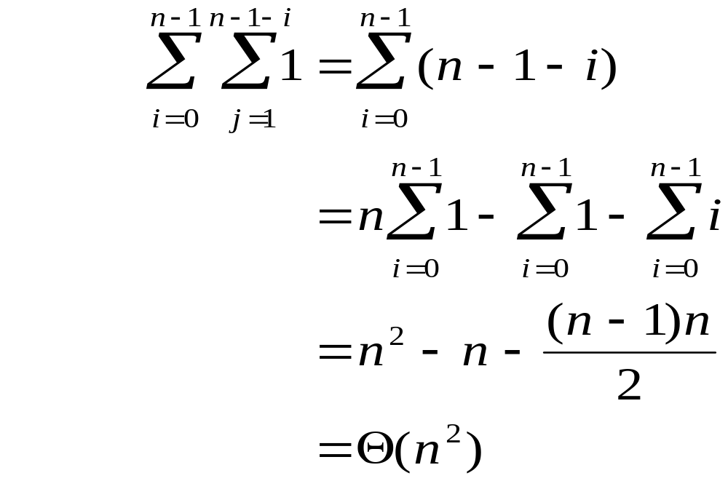
Bubble sort runtime
Running time (# comparisons) for input size n:
  number of actual swaps performed depends on the data; out-of-order data performs many swaps

Slide 15
Selection sort
selection sort: orders a list of values by repetitively putting a particular value into its final position
more specifically:
  find the smallest value in the list
  switch it with the value in the first position
  find the next smallest value in the list
  switch it with the value in the second position
  repeat until all values are in their proper places

Slide 16
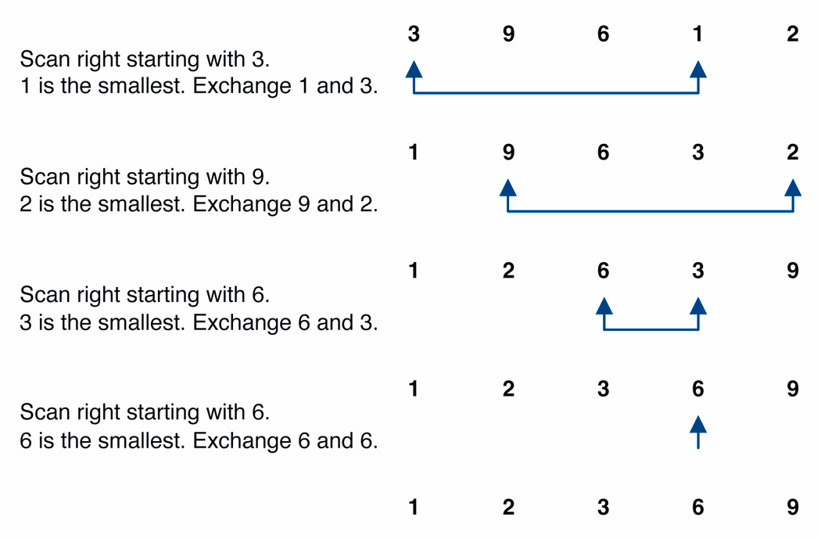
Selection sort example

Slide 17
Selection sort example 2
Index | 0 | 1 | 2 | 3 | 4 | 5 | 6 | 7
Value | 27 | 63 | 1 | 72 | 64 | 58 | 14 | 9
1st pass | 1 | 63 | 27 | 72 | 64 | 58 | 14 | 9
2nd pass | 1 | 9 | 27 | 72 | 64 | 58 | 14 | 63
3rd pass | 1 | 9 | 14 | 72 | 64 | 58 | 27 | 63
…
Notes:
The selection sort marks the first element (27). It then goes through the remaining
data to find the smallest number(1). It swaps this with the first element and the smallest element is now in its correct position. It then marks the second element (63) and looks through the remaining data for the next smallest number (9). These two numbers are then swapped. This process continues until n-1 passes have been made.

Slide 18
Selection sort code
public static void selectionSort(int[] a) {
for (int i = 0; i < a.length; i++) {
// find index of smallest element
int minIndex = i;
for (int j = i + 1; j < a.length; j++) {
if (a[j] < a[minIndex]) {
minIndex = j;
}
}
// swap smallest element with a[i]
swap(a, i, minIndex);
}
}

Slide 19
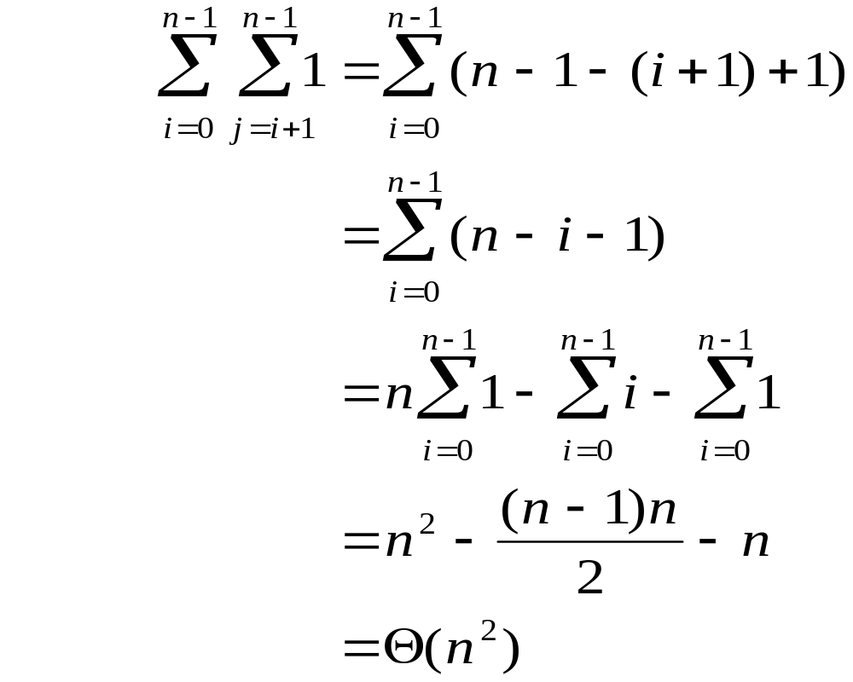
Selection sort runtime
Running time for input size n:
  In practice, a bit faster than bubble sort. Why?
Notes:
faster because fewer swaps are made. (Constant c is smaller on O(n^2).)

Slide 20
Insertion sort
insertion sort: orders a list of values by repetitively inserting a particular value into a sorted subset of the list
more specifically:
  consider the first item to be a sorted sublist of length 1
  insert the second item into the sorted sublist, shifting the first item if needed
  insert the third item into the sorted sublist, shifting the other items as needed
  repeat until all values have been inserted into their proper positions

Slide 21
Insertion sort
Simple sorting algorithm.
  n-1 passes over the array
  At the end of pass i, the elements that occupied A[0]…A[i] originally are still in those spots and in sorted order.
2 | 15 | 8 | 1 | 17 | 10 | 12 | 5
0 | 1 | 2 | 3 | 4 | 5 | 6 | 7
after
pass 2
2 | 8 | 15 | 1 | 17 | 10 | 12 | 5
0 | 1 | 2 | 3 | 4 | 5 | 6 | 7
after
pass 3
1 | 2 | 8 | 15 | 17 | 10 | 12 | 5
0 | 1 | 2 | 3 | 4 | 5 | 6 | 7

Slide 22
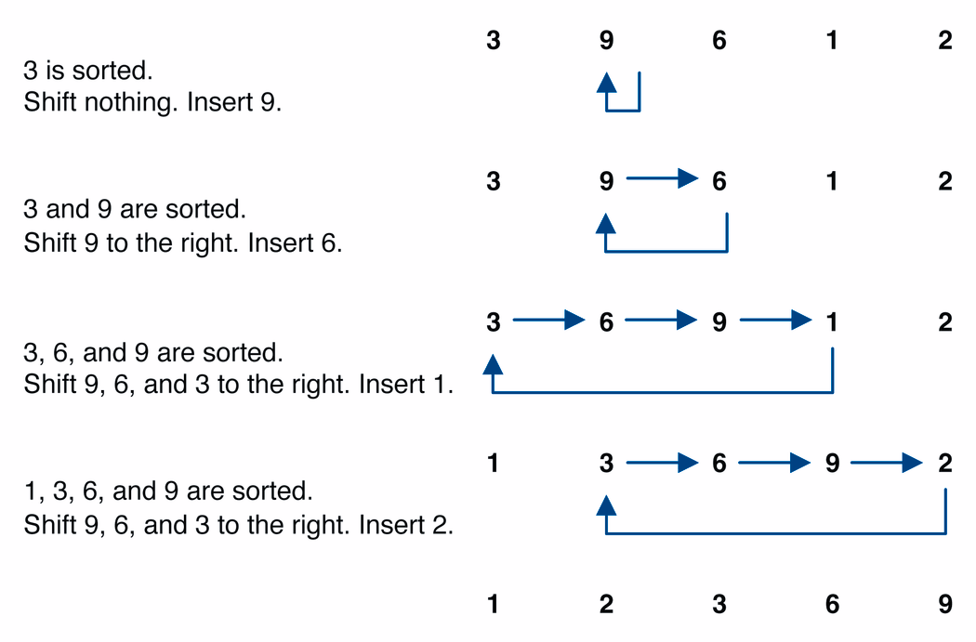
Insertion sort example

Slide 23
Insertion sort code
public static void insertionSort(int[] a) {
for (int i = 1; i < a.length; i++) {
int temp = a[i];
// slide elements down to make room for a[i]
int j = i;
while (j > 0 && a[j - 1] > temp) {
a[j] = a[j - 1];
j--;
}
a[j] = temp;
}
}

Slide 24
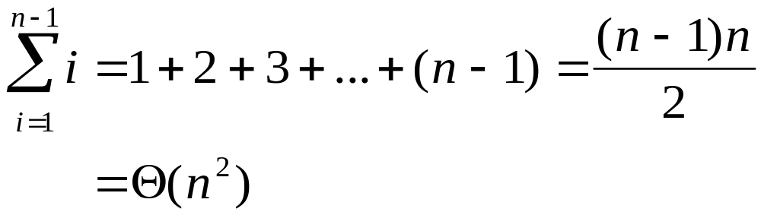
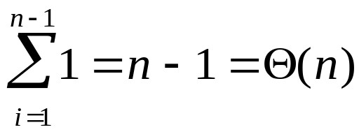
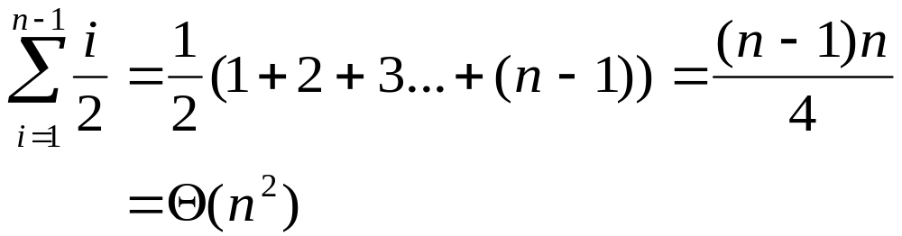
Insertion sort runtime
worst case: reverse-ordered elements in array.
best case: array is in sorted ascending order.
average case: each element is about halfway in order.

Slide 25
Comparing sorts
We've seen "simple" sorting algorithms so far, such as selection sort and insertion sort.
They all use nested loops and perform approximately n² comparisons
They are relatively inefficient

Slide 26
Sorting practice problem
Consider the following array of int values.
  [22, 11, 34, -5, 3, 40, 9, 16, 6]
  (a) Write the contents of the array after 3 passes of the outermost loop of bubble sort.
  (b) Write the contents of the array after 5 passes of the outermost loop of insertion sort.
  (c) Write the contents of the array after 4 passes of the outermost loop of selection sort.

